Slide 1
Data Science Sandbox/Platform – Gitlab Onboarding
Deck – Preetam Balijepalli
December 2019

Slide 2
Why should you care to version control?
Safeguard your code against accidental loss
To collaborate quickly and confidently, and to take code from idea to production faster than ever.
Review and ensure bugs are fixed and developers don’t break each others code
Automate checking that your code compiles and deploying your code
Documentation
Reproducibility!

Slide 3
Git……
Why git
simple, distributed version control system suitable even for non-developers high security against code corruption by hashing secure data transfers using SSH
How git, github,gitlab differ
Git: Software that handles source code versioning, letting you make and track local file changes and share changes with a remote repository.
GitHub (i.e. https://github.com) : A cloud service for remote hosting of git repositories. In addition to hosting your code, the site helps manage software development projects with features like issue tracking, collaborating with other GitHub users, and hosting web pages.
Offers both open source public to all and private paid repositories
GitHub, you can decide if someone gets a read or write access to a repository.
Can be integrated with 3rd party CI/CD tools
GitLab (i.e. https://gitlab.syngenta.org):GitLab (a cloud service a lot like GitHub) comes in two flavors, a publically available cloud service and a cloud service for
GitLab you can set and modify people’s permissions according to their role.
GitLab you can provide access to the issue tracker without giving permission to source code
Free Continuous Integration/Delivery of GitLab. CI is a huge time saver for many development teams
Can export (without any restrictions)
Wiki and project repositories
Project uploads
The configuration including web hooks and services
Issues with comments, merge requests with diffs and comments, labels, milestones, snippets, and other project entities

Slide 4
Handshake : With SSH Key
ssh-keygen -t rsa -b 4096 -C "you@computer-name„
chmod 600 ~/.ssh/id_rsa
ls -altr .ssh/
cat ~/.ssh/id_rsa.pub
chmod 700 ~/.ssh
touch ~/.ssh/authorized_keys
chmod 600 ~/.ssh/authorized_keys
cat ~/.ssh/id_rsa.pub >> ~/.ssh/authorized_keys
ssh -vT git@git.syngentaaws.org
git clone https://git.syngentaaws.org/<project-group>/project.git

Slide 5
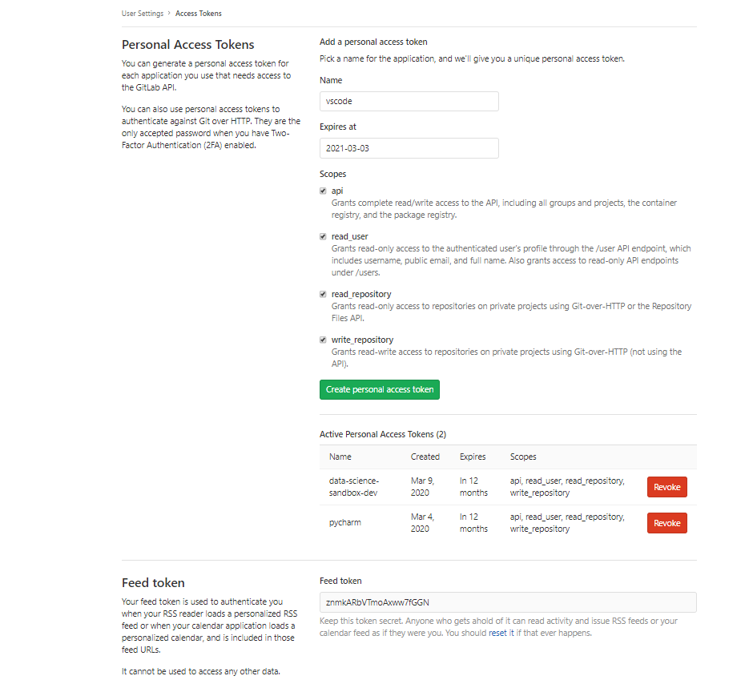
Personal Code
https://git.syngentaaws.org/profile/personal_access_tokens

Slide 6
Git commands
git config --global user.name "Your Name"
git config --global user.email you@example.com
git status
git diff
git add <file>
git commit -m 'My change'
git push origin master
git log
https://github.github.com/training-kit/downloads/github-git-cheat-sheet.pdf

Slide 7
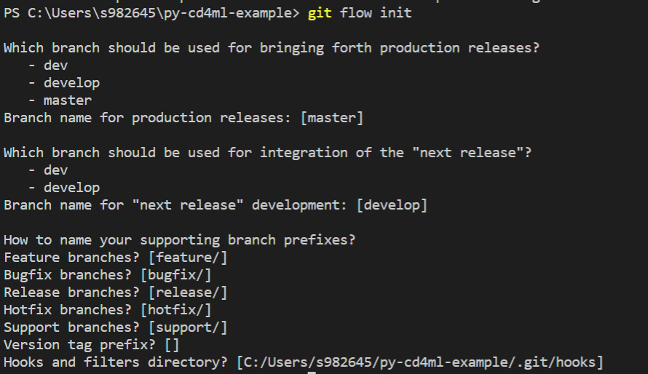
GitFlow Commands
git branch develop
git push -u origin develop
https://www.atlassian.com/git/tutorials/comparing-workflows/gitflow-workflow
https://medium.com/@patrickporto/4-branching-workflows-for-git-30d0aaee7bf

Slide 8
Code Review
Why do code review ?
Problems in code are detected and corrected right away
Every member of the team, not just the author of the code, is responsible for its quality
Knowledge sharing happens fast and effectively , Juniors can learn too !, Hence everyone in the team knows the code .
Bad code does not accumulate , hence high quality product code can be created.
How to do with GitLab?
GitLab merge request as a tool for code review
Write code and push it to a separate branch.
A merge request is meant for merging code from one branch to another. The main merge request parameters (specified when creating a merge request) are:
source branch
target branch
title
description
assignee
Wait until your request is accepted or declined with comments about necessary fixes.
Take part in discussions about fixes. (GitLab allows you to respond to comments.)
Make fixes and push changes to your branch.

Slide 9
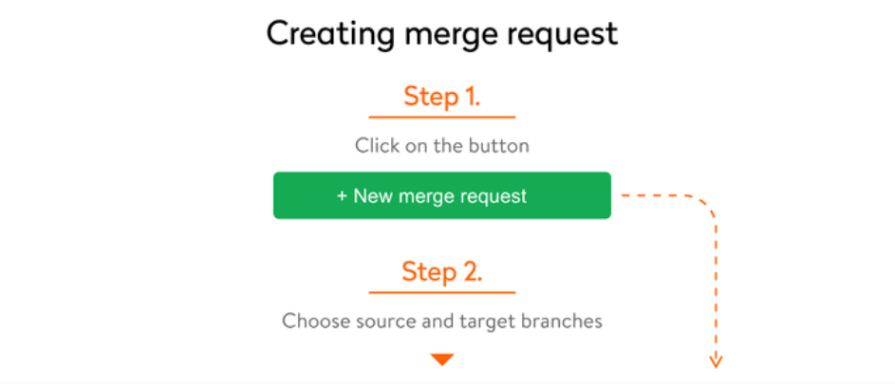
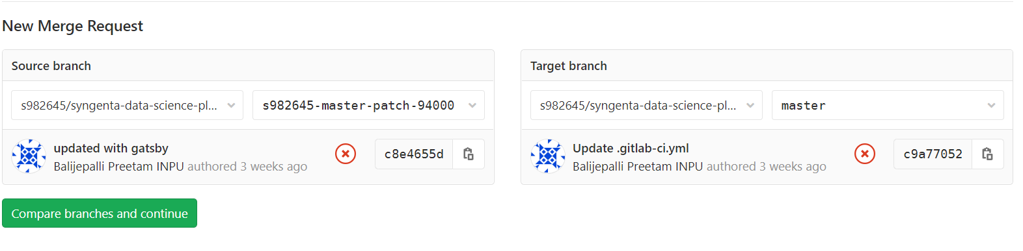
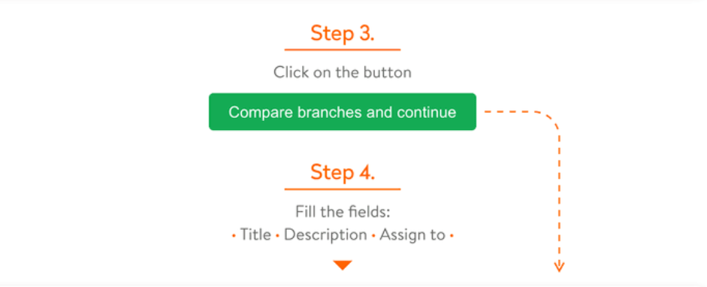
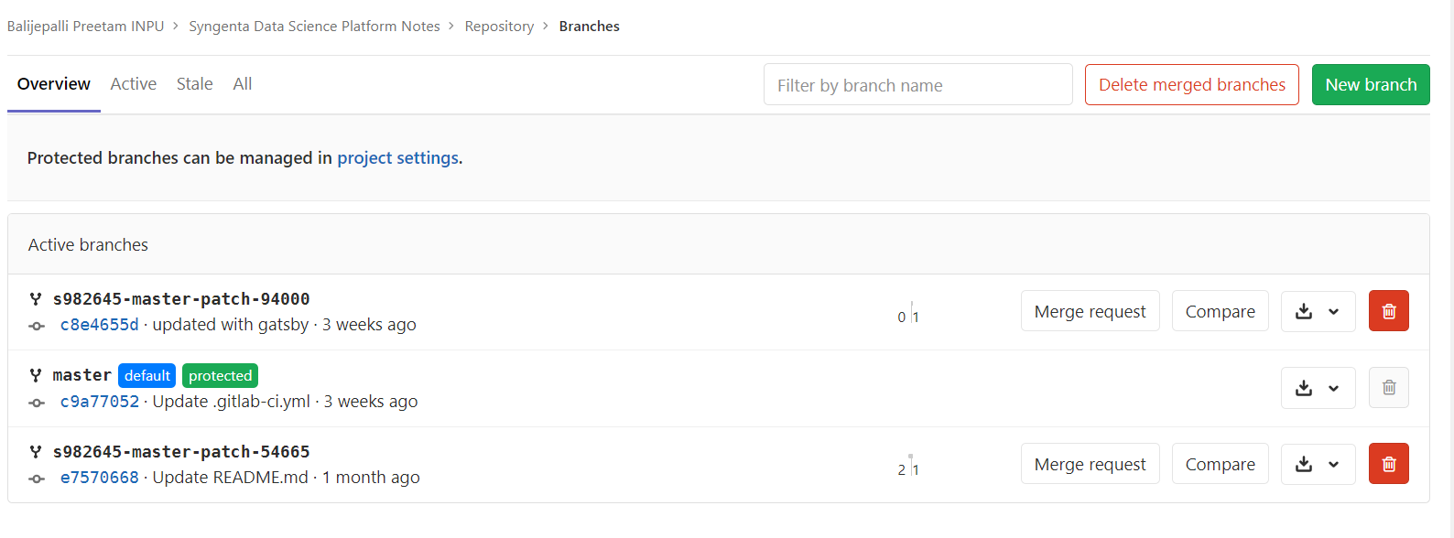
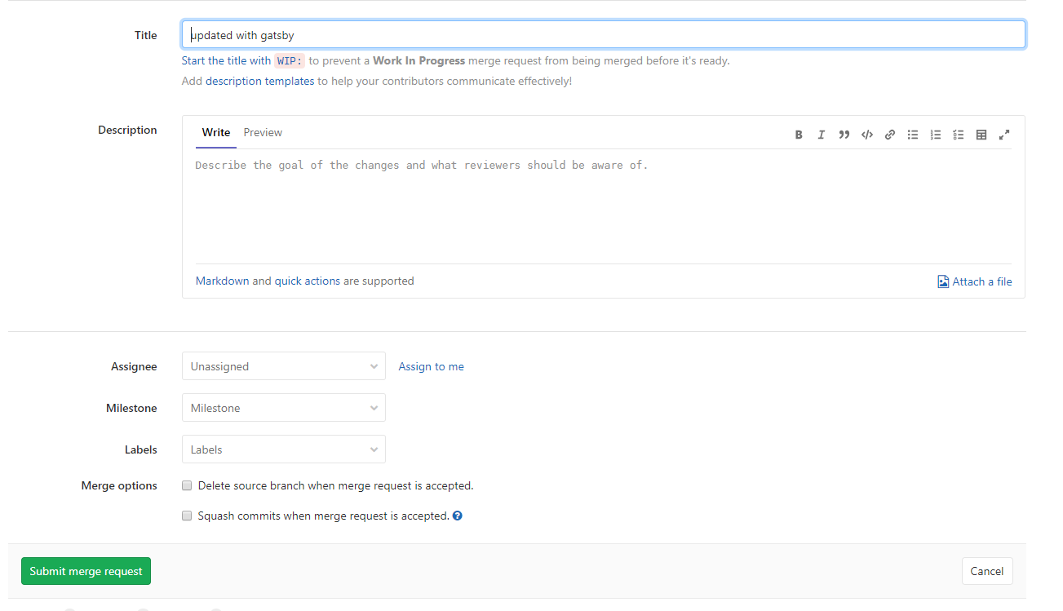
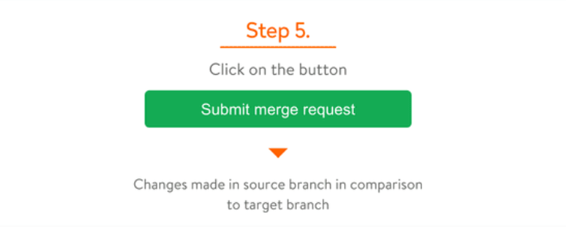

Slide 10
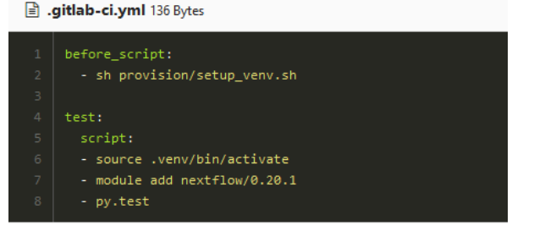
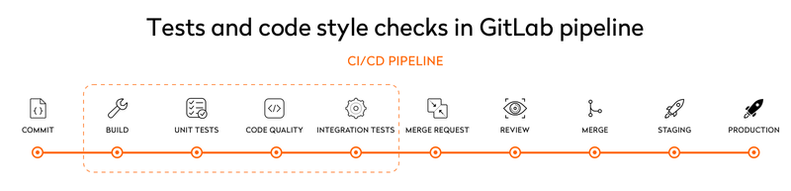
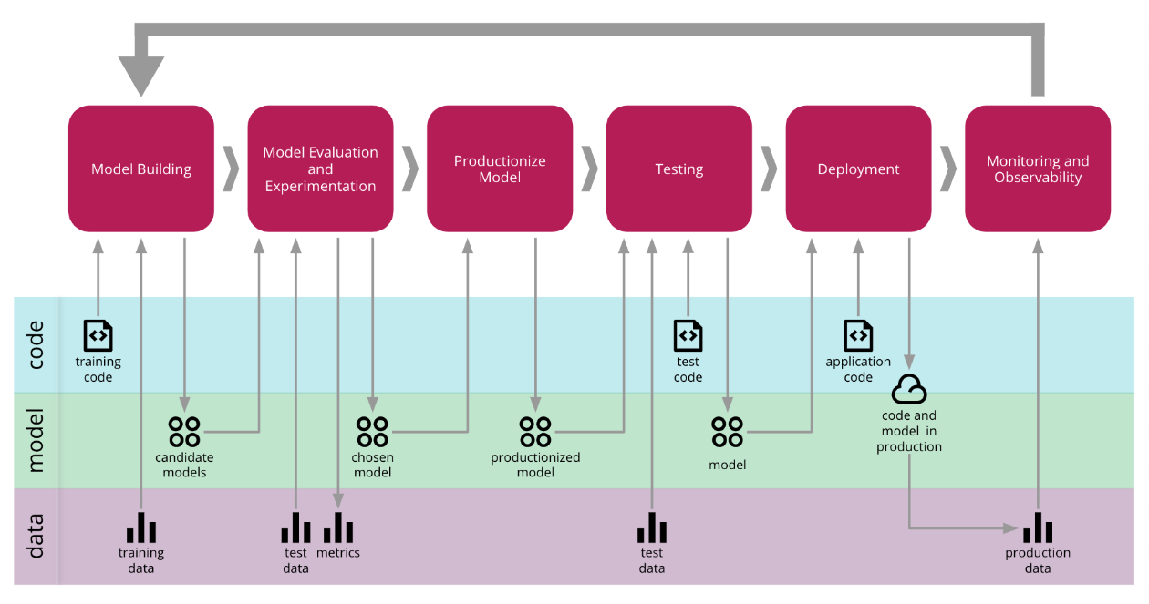
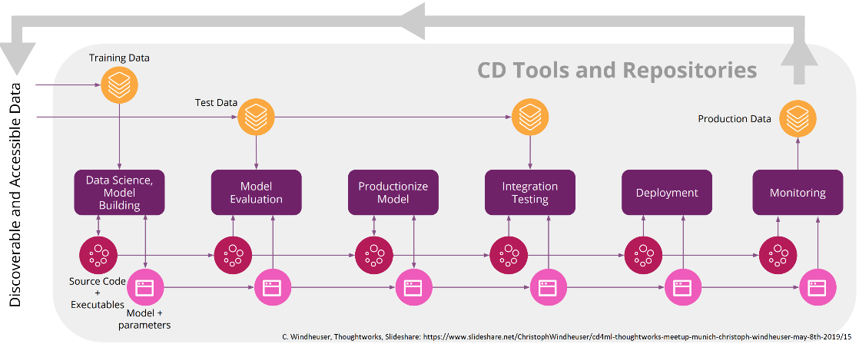
The CI Configuration File
Standard YAML (Yet Another Markup Language), Very human-friendly
.gitlab-ci.yml, in the top directory of your git repository
Describes pipelines which consist of stages
Each stage has a specific function: build, test, deploy…
Each stage can have its own tags (required environment)
Each stage can produce artefacts/re-use from other stages
Stages can run in parallel
Check/debug your YAML file at https://git.syngentaaws.org/<user>/<project>/-/ci/lint

Slide 11
Demo
pycharm
vscode
ec2
rstudio

Slide 12
Next Demo – To be Scheduled
Integration with
Version control of Jupyter notebooks
AWS sage maker platform
ML Flow rest API
webhooks

Slide 13

Life Cycle
Ideation
Proceed
Kick Start
Identity the Problem
Project Scoping
Create Backlog
Feasibility
Data?
Identify Sources
Data Acquisition
Explore Data
Prepare Data
Make Data Discoverable for Other Data Scientists
Create
Create ML Code
Feature Engineering
Create Train Model
Build ML Pipeline to train Local/Cloud
Add to Model Repository
Add to source code
Create and Train
Feature Repository
Deploy
Pull and Deploy
Deploy Model to Local/Cloud
Update Model Repository with Metadata
Monitor
Automated Deployment to Prod
Deploy Model to Local/Cloud
Monitor Model Performance

Slide 14
Your Turn
Getting started with Git :https://www.katacoda.com/courses/git
http://balijepalli.com/intro_to_git_course/
Getting started with GitLab : https://www.youtube.com/playlist?list=PLLnpHn493BHGgDmJGfCzRYRkFYWcRrxDT
Code review with GitLab : https://about.gitlab.com/blog/2017/03/17/demo-mastering-code-review-with-gitlab/
Continuous delivery for ML : https://martinfowler.com/articles/cd4ml.html
Configuration of extensions/plugins to an IDE
pycharm :
vscode :
https://medium.com/@brygrill/version-control-basics-with-github-and-vs-code-1c1906cadd33
https://github.com/fatihacet/gitlab-workflow
rstudio:
https://support.rstudio.com/hc/en-us/articles/200532077?version=1.2.1335&mode=server
https://www.youtube.com/watch?v=ulu2MNV1OCc

Slide 15


Thank You !

